Slide 1
Update for Kaitlin
Joren Janzing
19/1

Slide 2
So far:
Look at zonal winds over Amundsen Sea shelf break in different Pacific Pacemaker simulations. What degree of consensus is there, among these models, that the 1940s was actually an exceptional time for winds?

Slide 3
Content
What is special about the 1940s ENSO event?
What consensus is there in PACE that 1940s winds are exceptional?
How does it compare with ERA5?
Other influences besides ENSO?

Slide 4
What made 1940s El Niño event different?

Slide 5
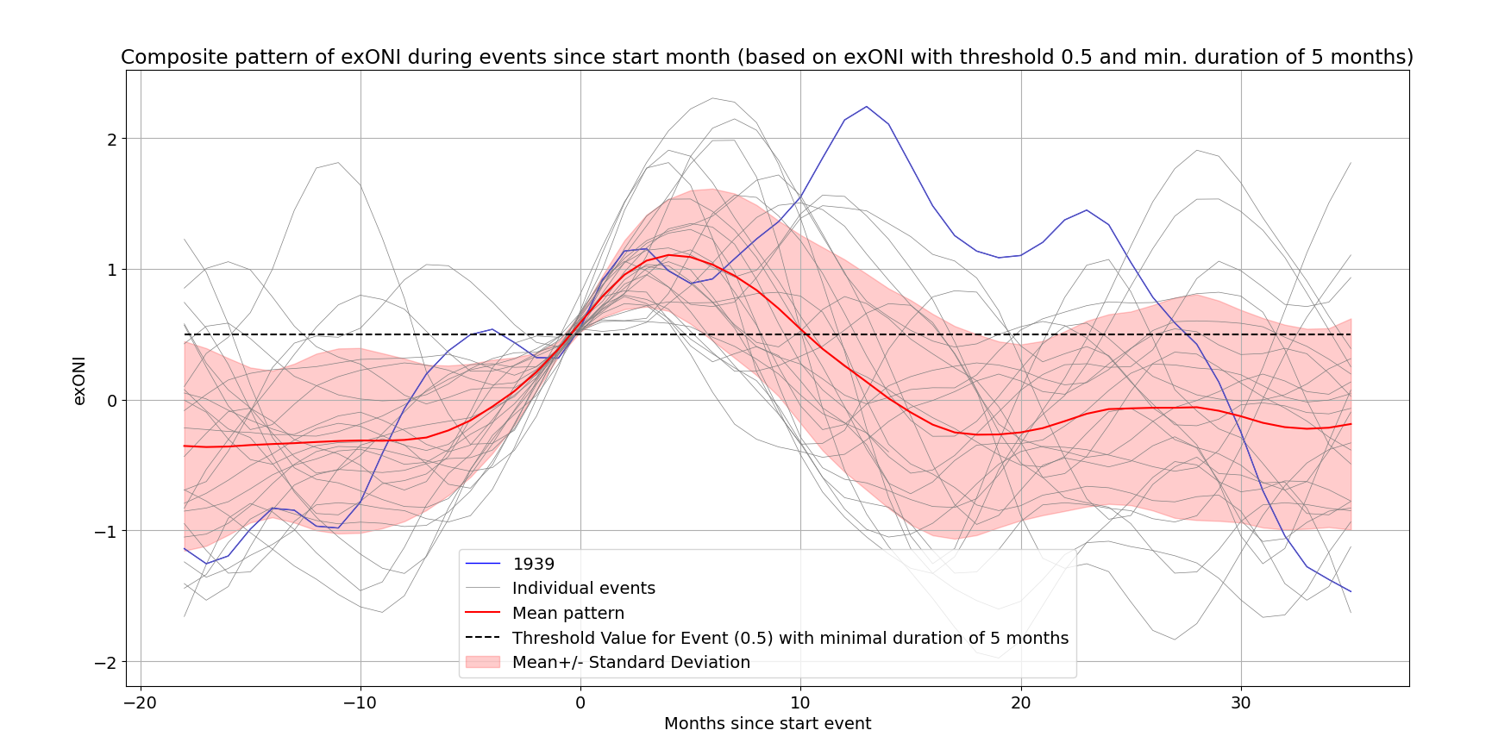
ONI over threshold of 0.5 for a minimal duration of 5 months (NOAA definition).
Time in months since the start of the detection.
Blue line shows the 1940 event.

Slide 6
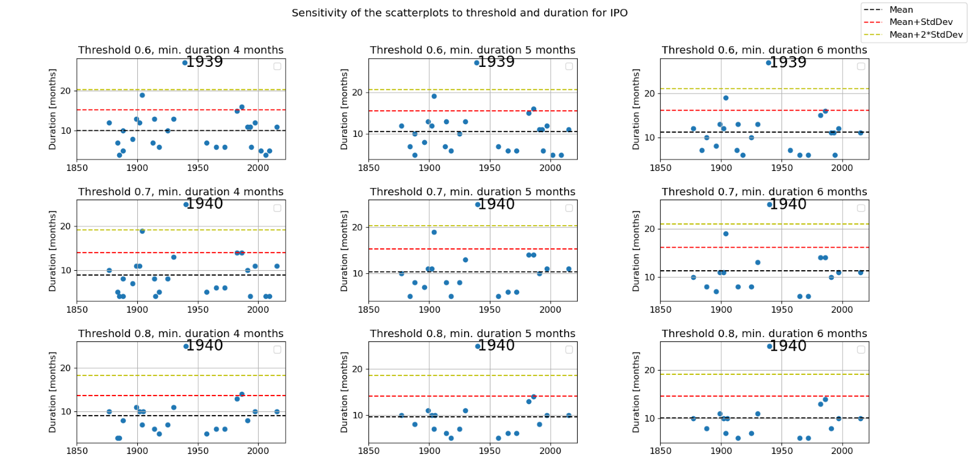
Longest event: not sensitive to threshold and min. duration

Slide 7
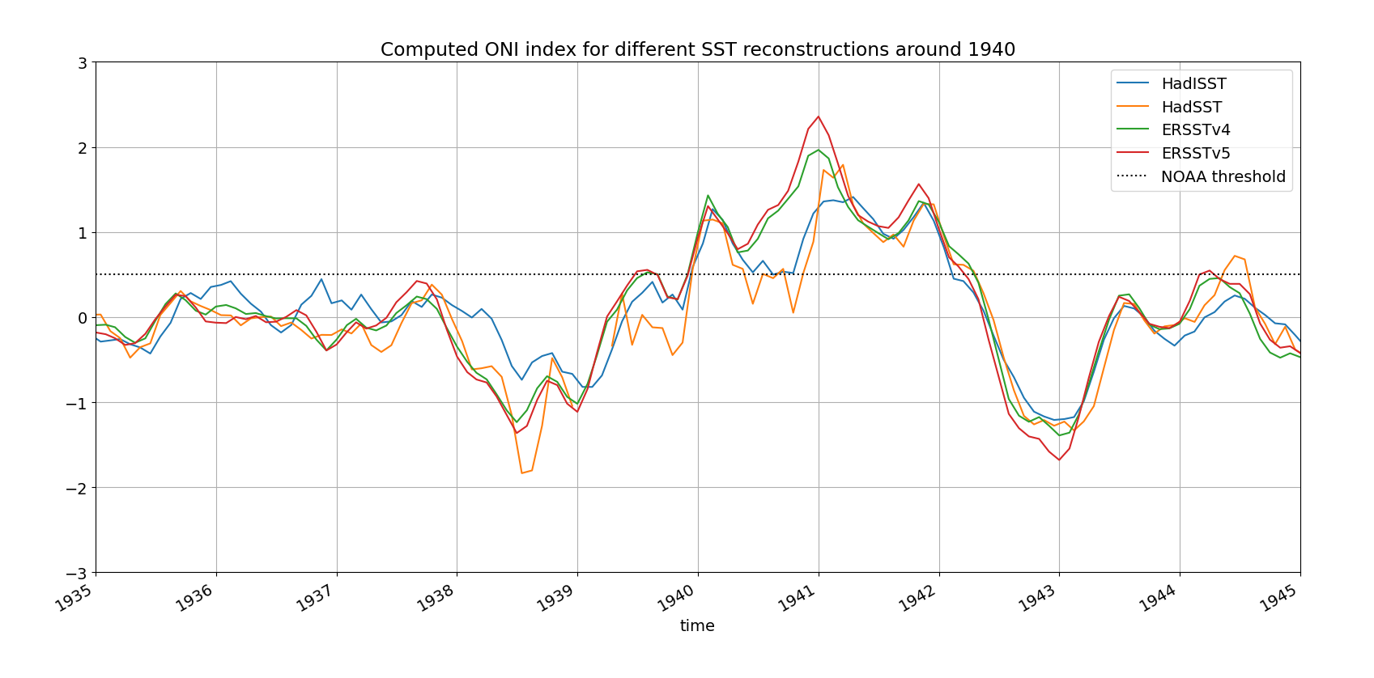
ONI
One or two seperate events? Depends on which SST reconstruction is used

Slide 8
What made the 1940s ENSO event special?
Probably the longest period in the 20th century with El Niño like conditions.
Possibly separated into two events, depending on the reconstruction that you use.
It seems to exist of three phases.

Slide 9
What consensus is there in PACE that 1940s winds are exceptional?

Slide 10
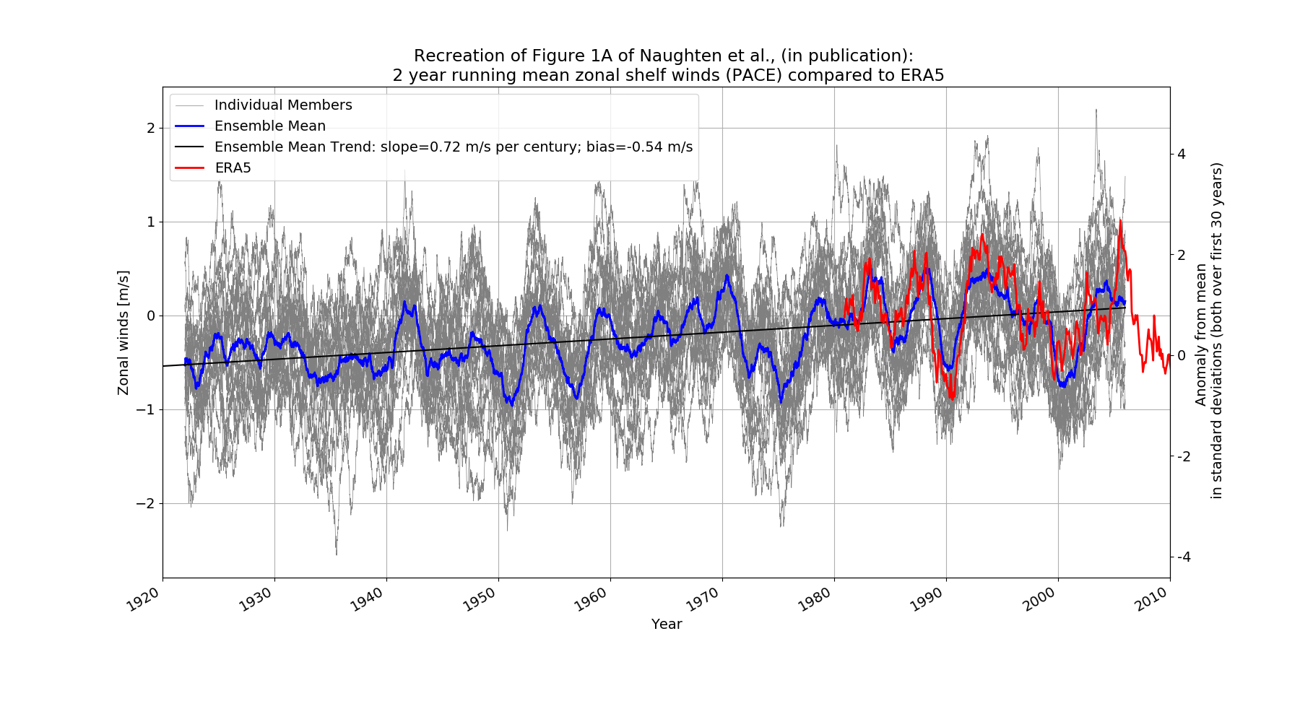
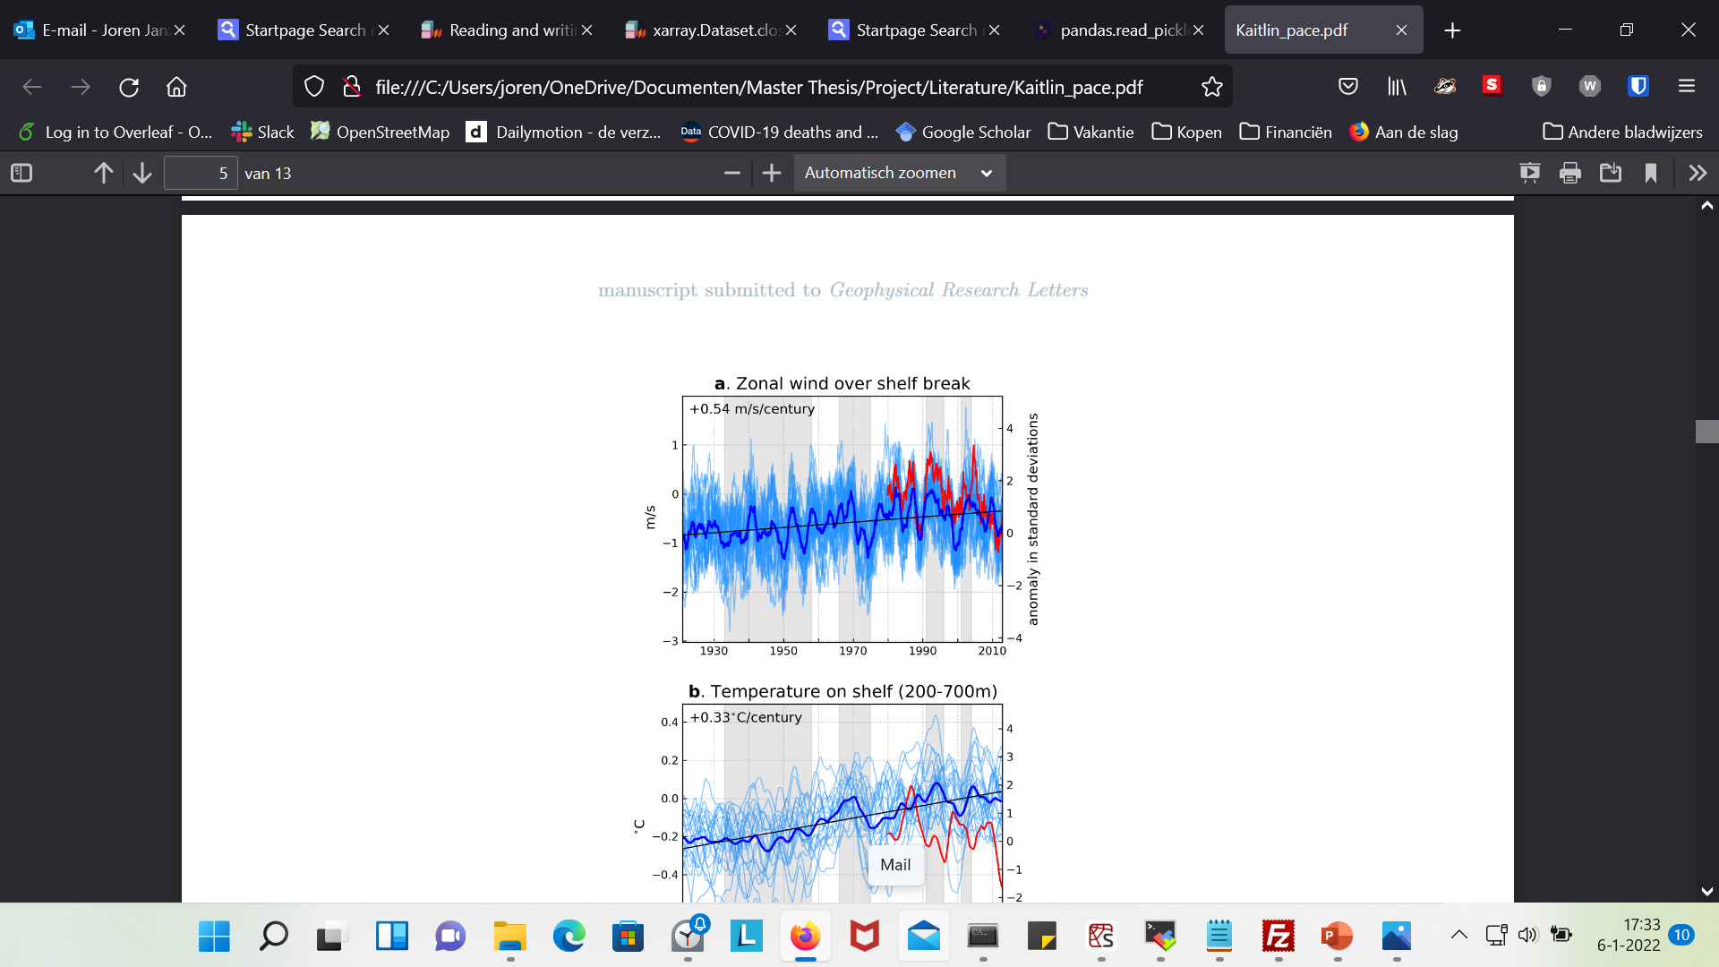
Fig 1A Naughten (concept)

Slide 11
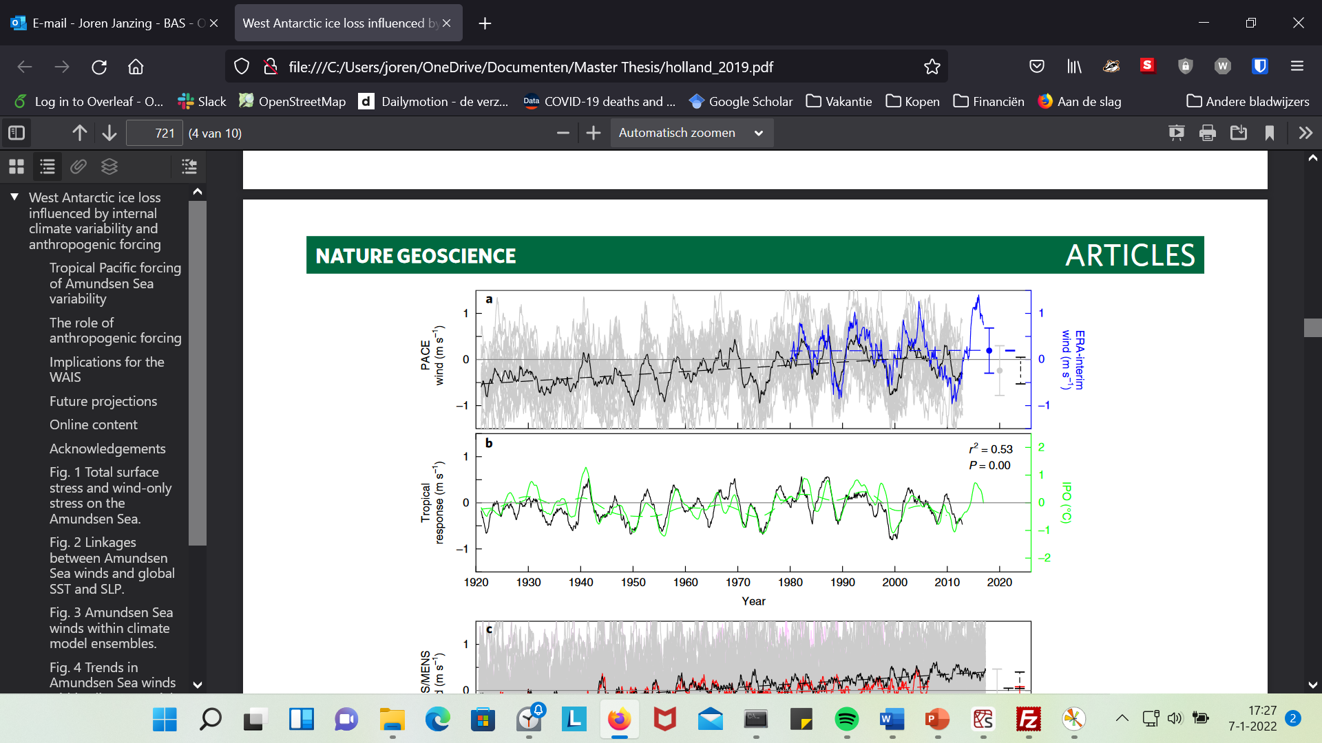
Fig 3A Holland et al., 2019

Slide 12
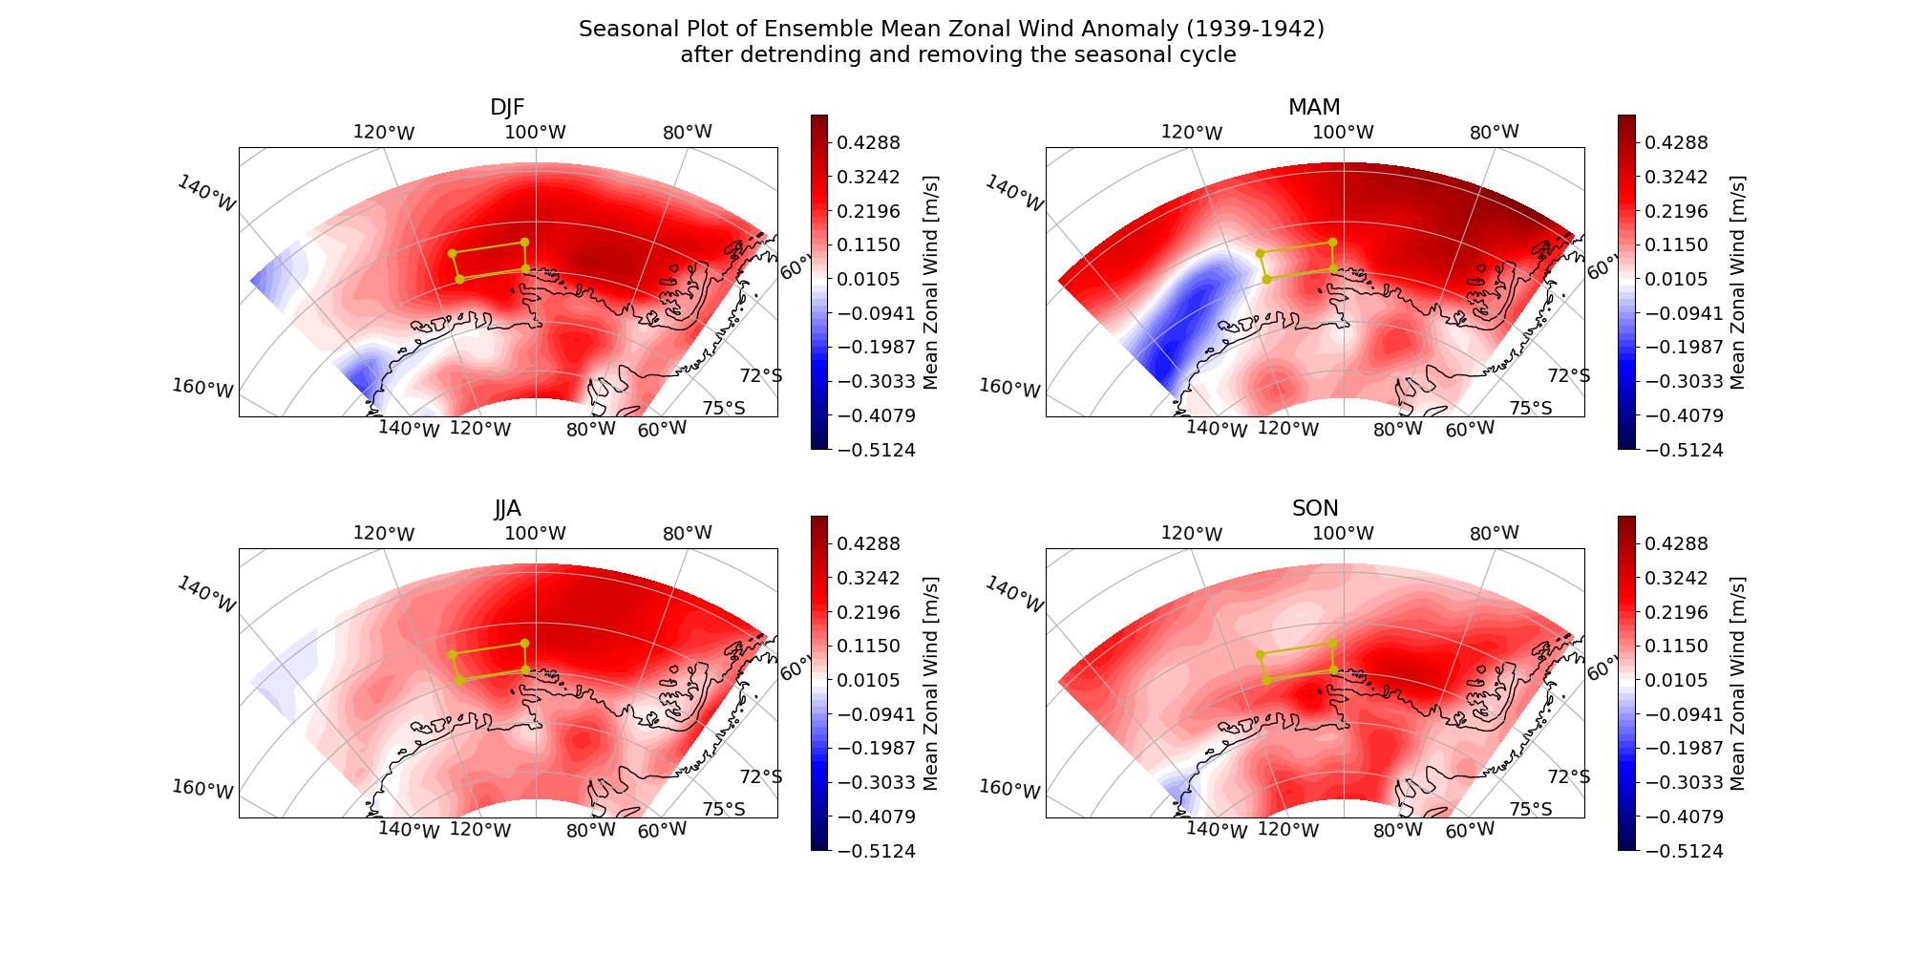

Slide 13
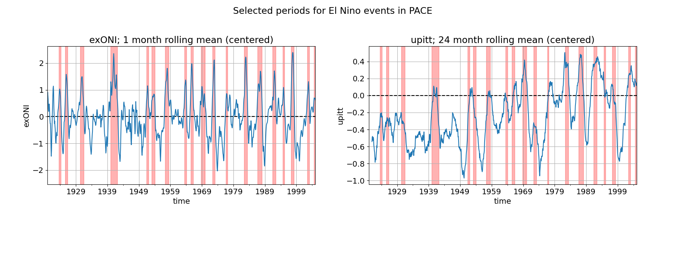

Slide 14
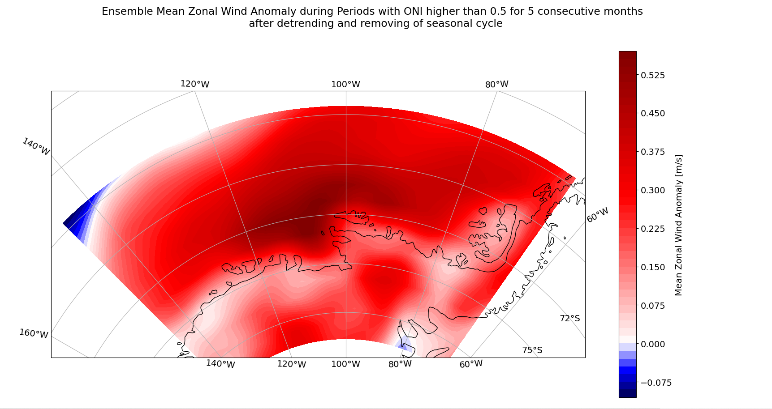

Slide 15
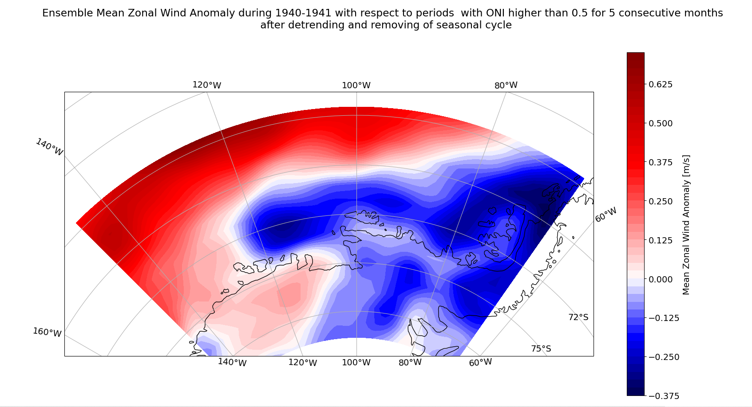

Slide 16
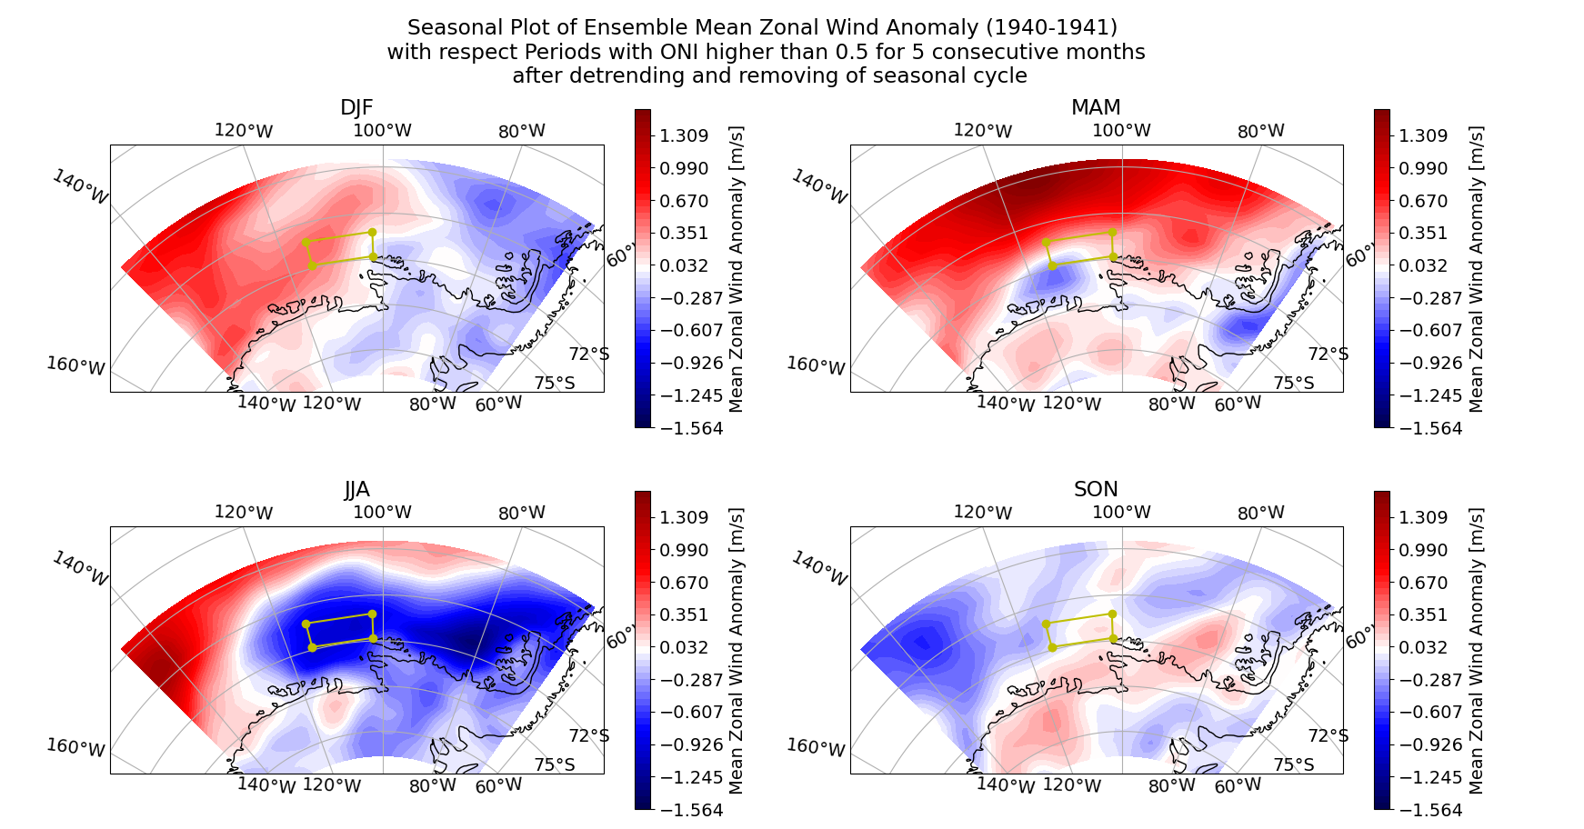

Slide 17
Are the 1940s an exceptional time for zonal shelf winds?
Positive zonal wind anomaly in all seasons over 1939-1942 period
Possibly the first time ensemble mean of zonal shelf winds were westerly? Could be a threshold?
Not necessarily the strongest anomaly.
ENSO like pattern, but weaker at shelf edge?

Slide 18
Present day bias with respect to ERA5

Slide 19
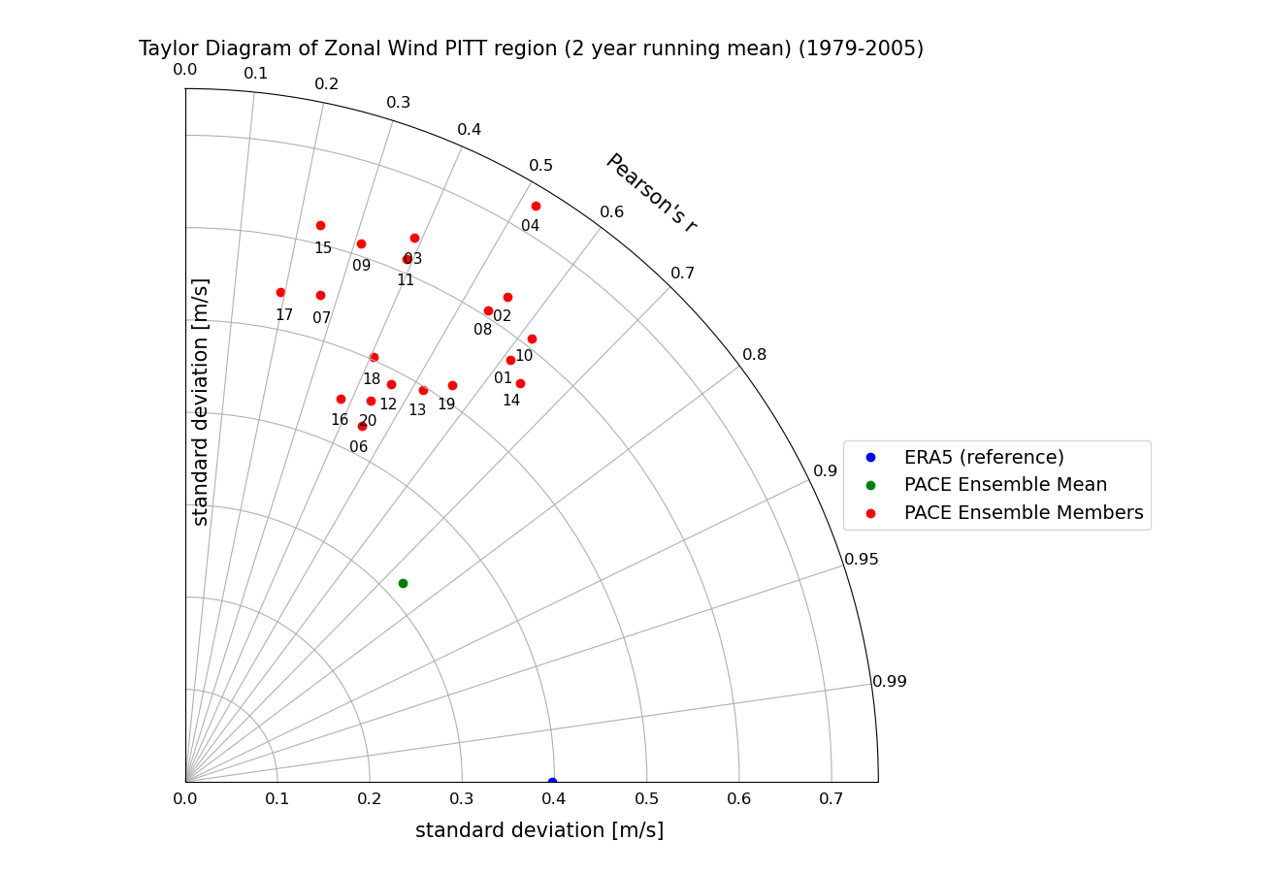
Ensemble Mean Comes closest to the ERA5 data.
PACE members standard deviation is generally too high, but ensemble means standard deviation is a bit too low.

Slide 20
Influence of other factors on relationship between PACE and ENSO

Slide 21
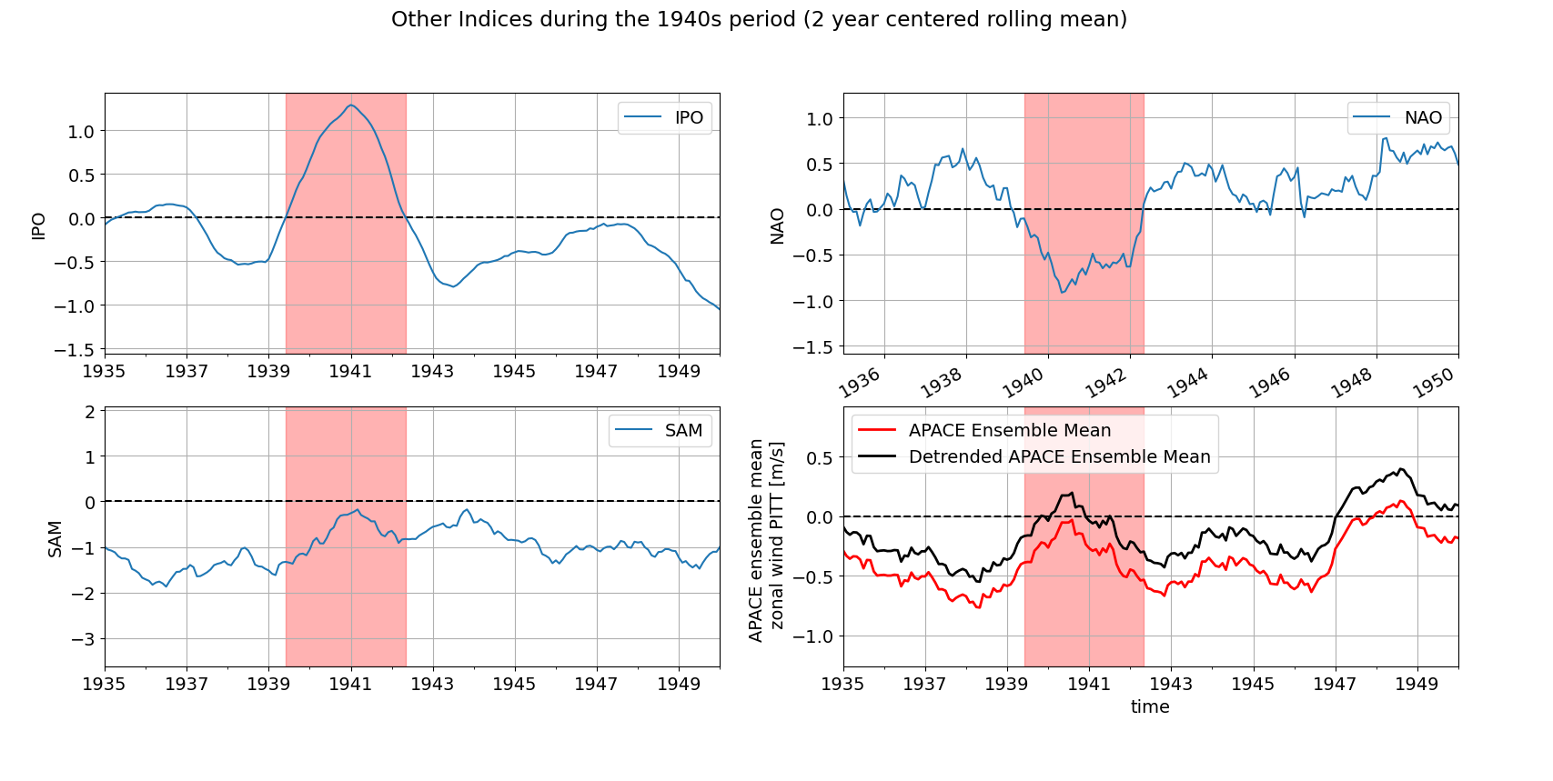

Slide 22
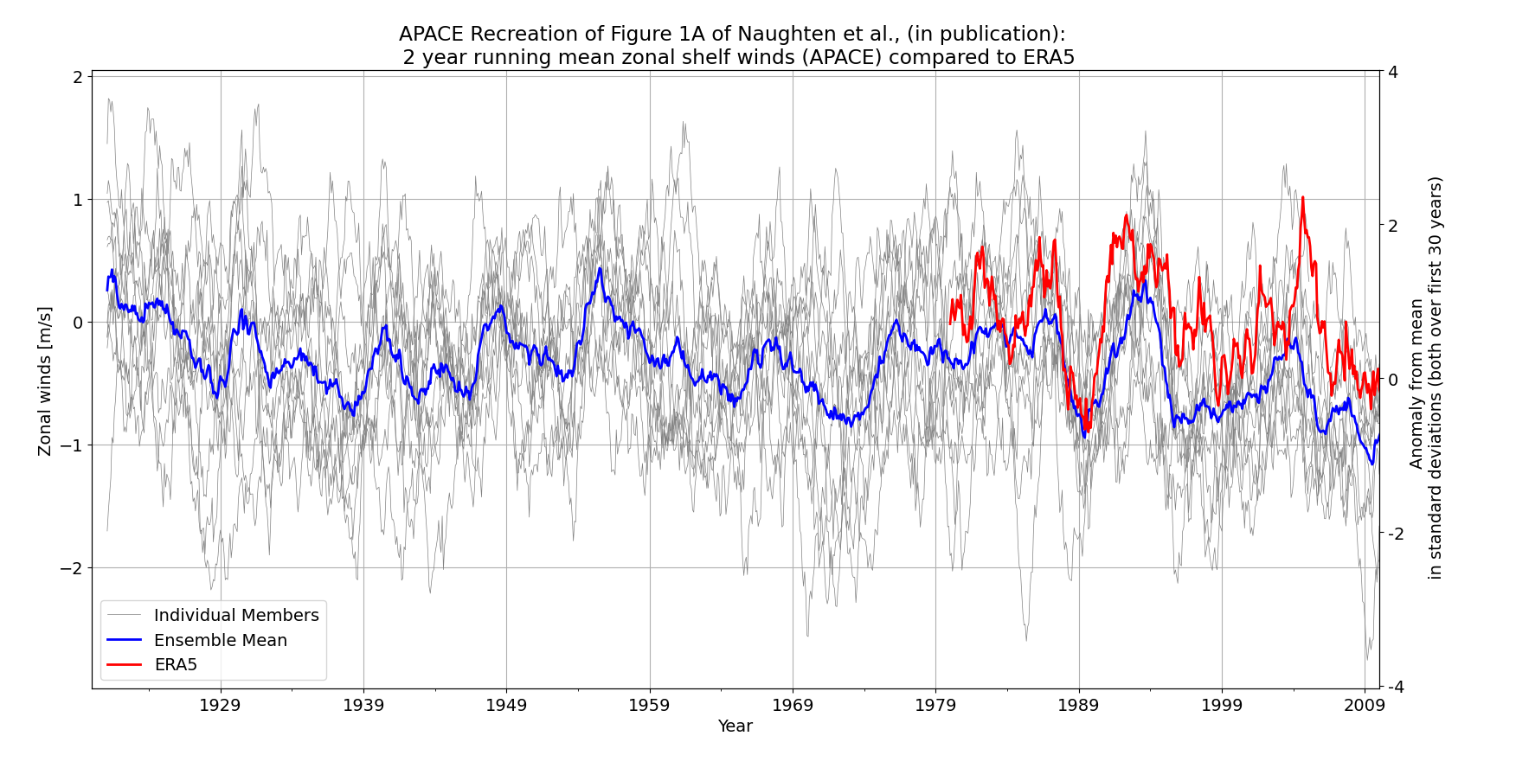

Slide 23
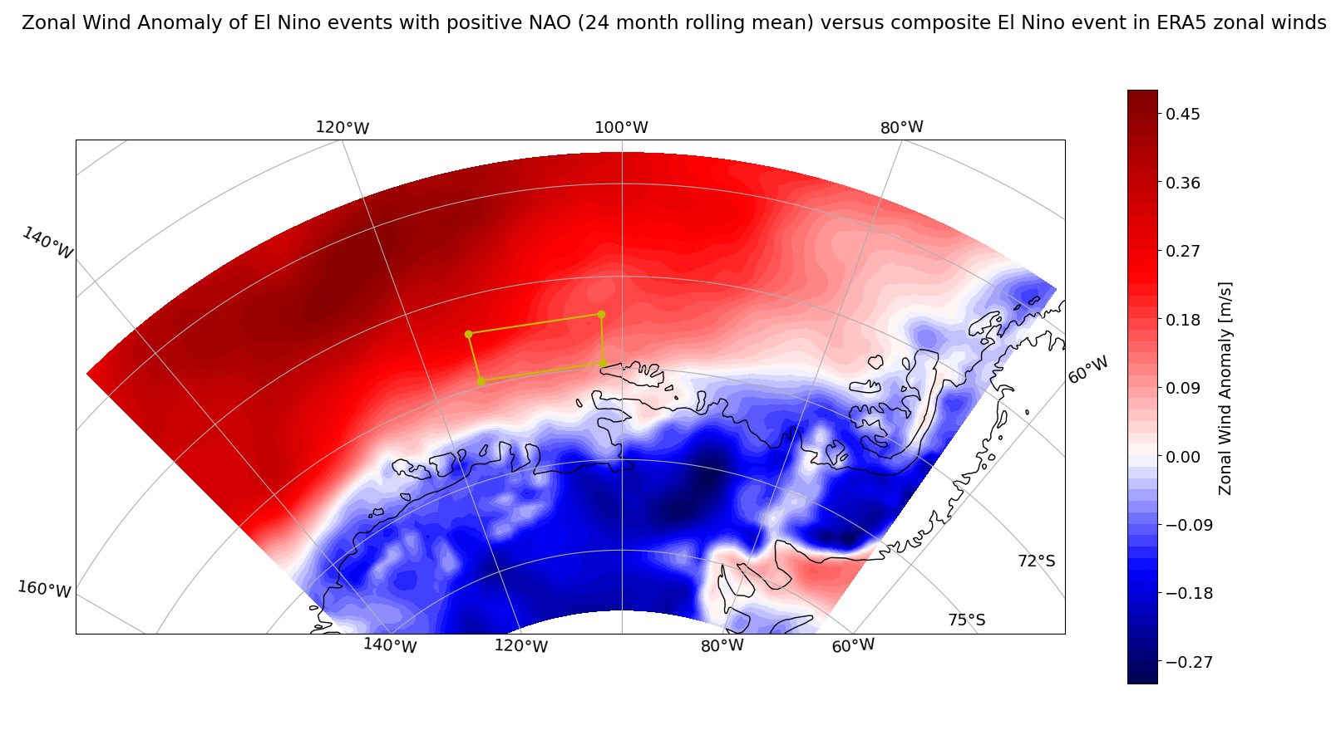

Slide 24
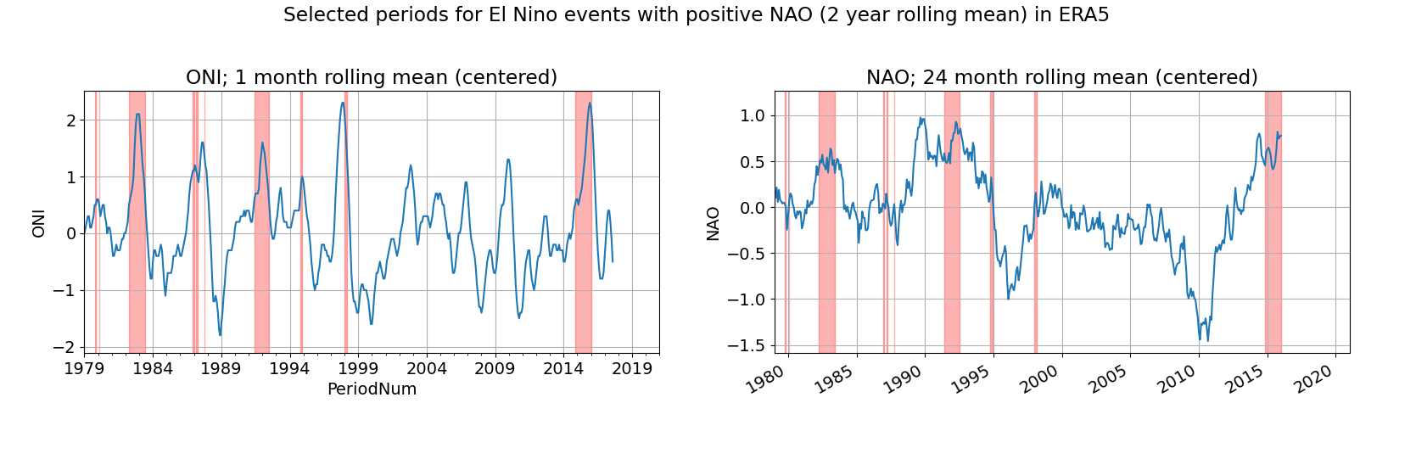

Slide 25
Other factors of influence
Possibly contribution of Atlantic
Needed to look at indices in PACE.

Slide 26
Following Steps: some ideas
Other research questions, such as ocean model data.
Indices from PACE ensemble members
Newer ensemble CESM2, IPACE, APACE more, historical runs (LENS)
Meeting with Paul Holland
Extra:
Document with some other things (Wavelet analysis, PCA)
Preliminary introduction
General points:
Housing
Visa

Slide 27
Extra

Slide 28
ERA5 data

Slide 29
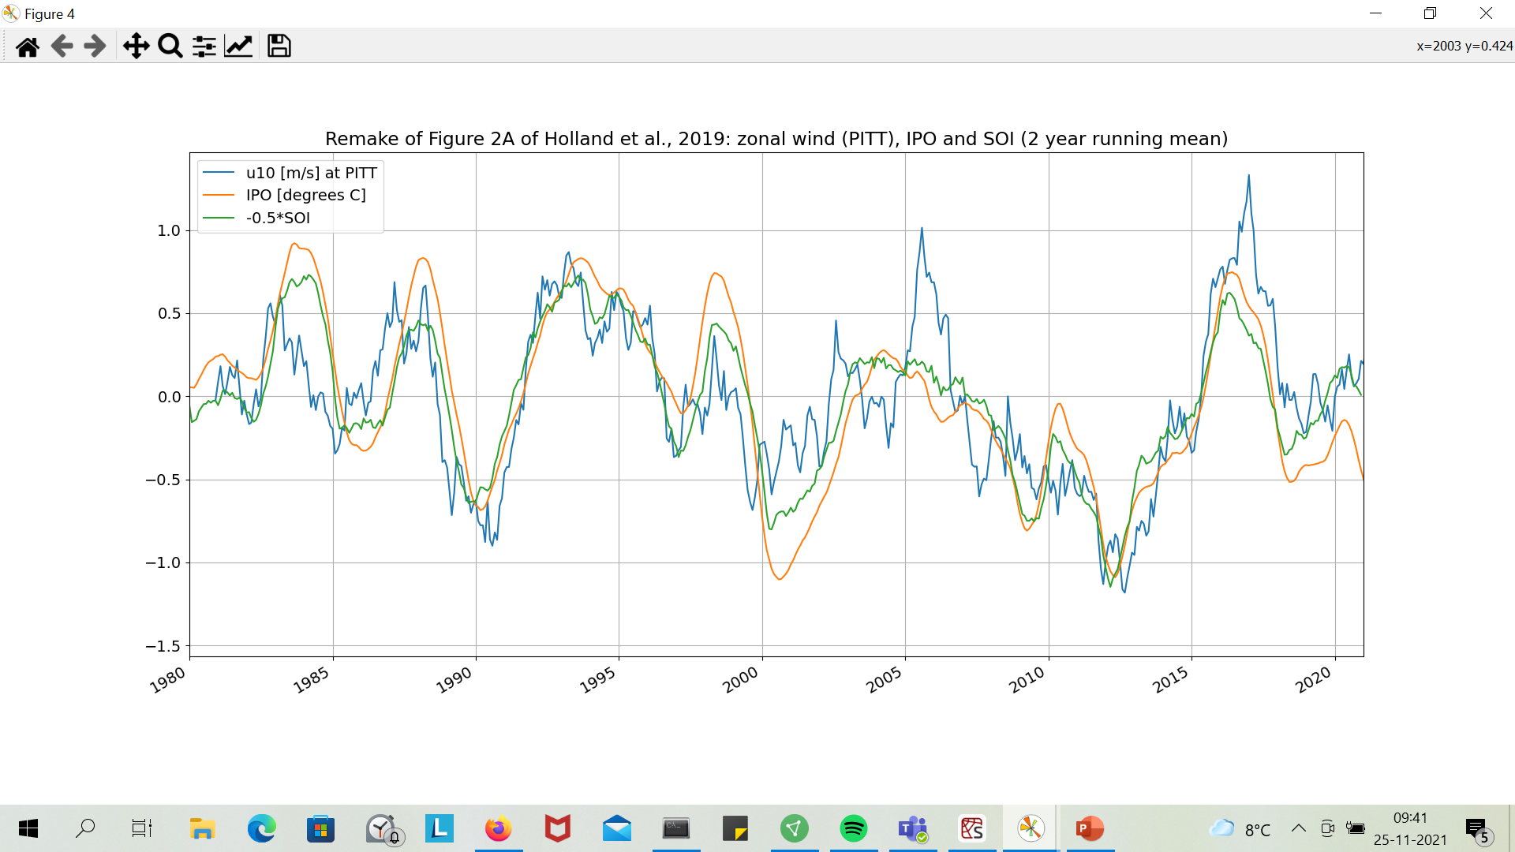
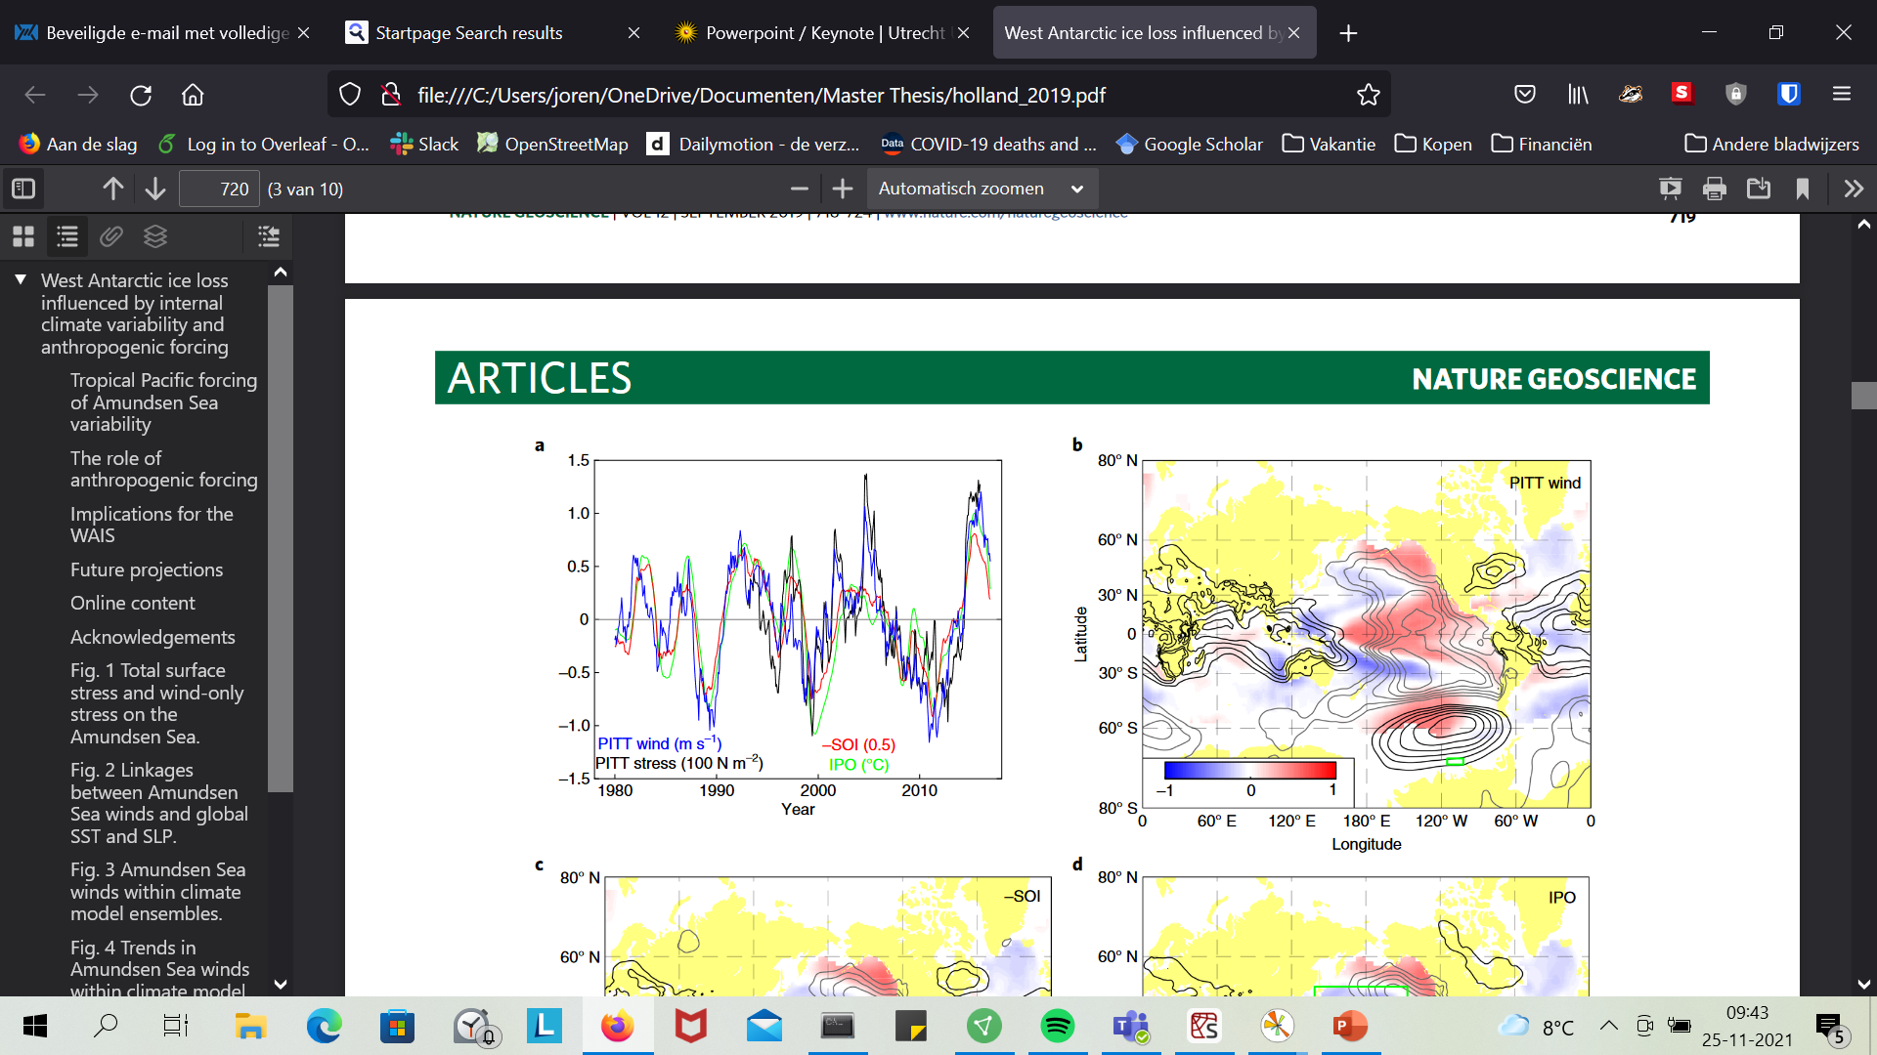
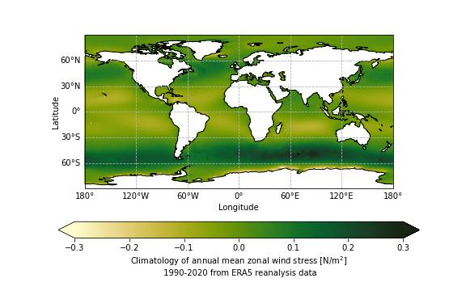
PITT winds and Climate Indices
Wind stress left out: very small, in Holland 100N/m^2→ mainly ice stress?
Wikipedia, Windstress
Fig 2a, Holland et al., 2019

Slide 30
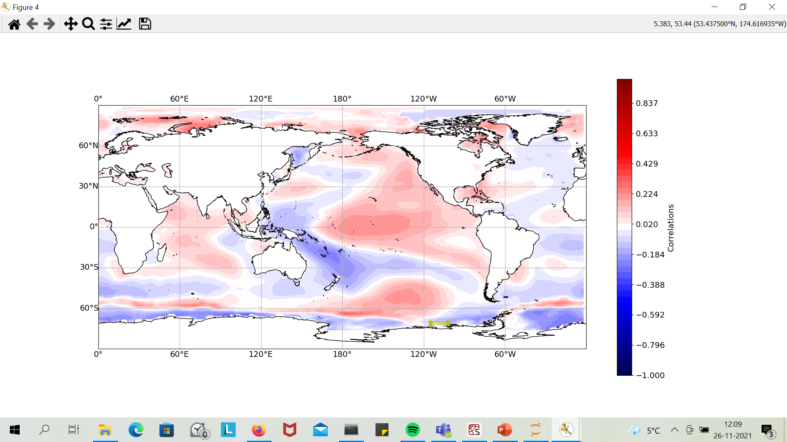
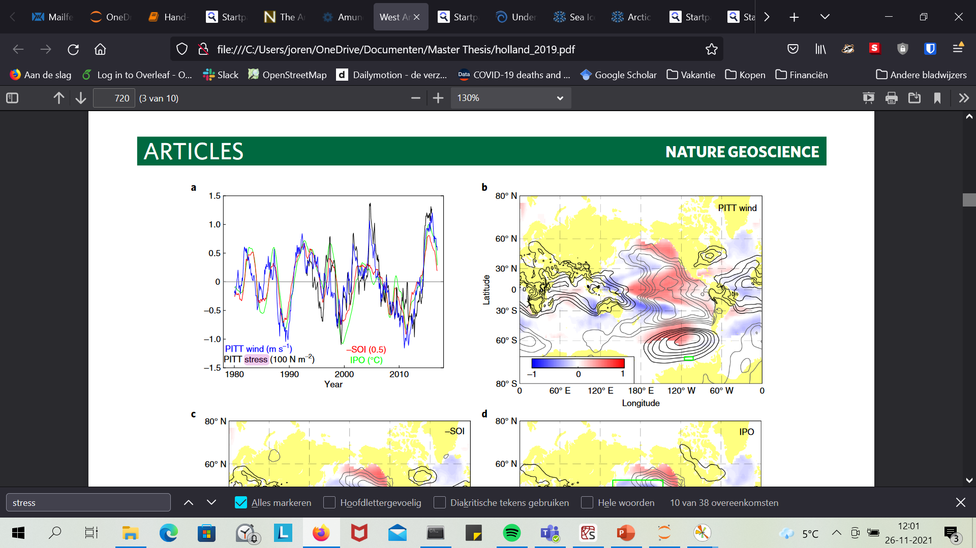
Correlation between PITT winds and SSTA (from ERSST)
Statistical significance left out in Holland?
SSTA anomaly corrected for climate change?
Projection
Fig 2b, Holland et al., 2019

Slide 31
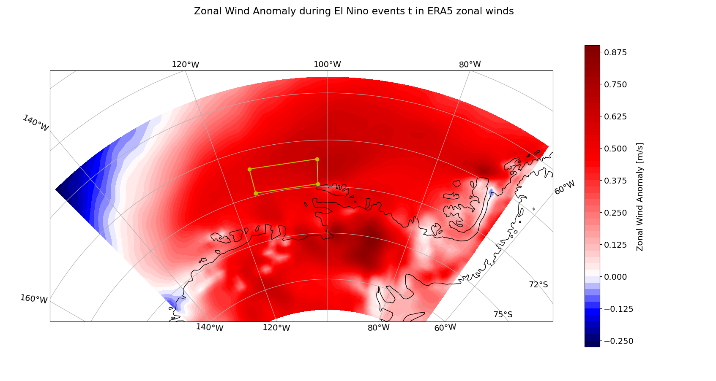

Slide 32
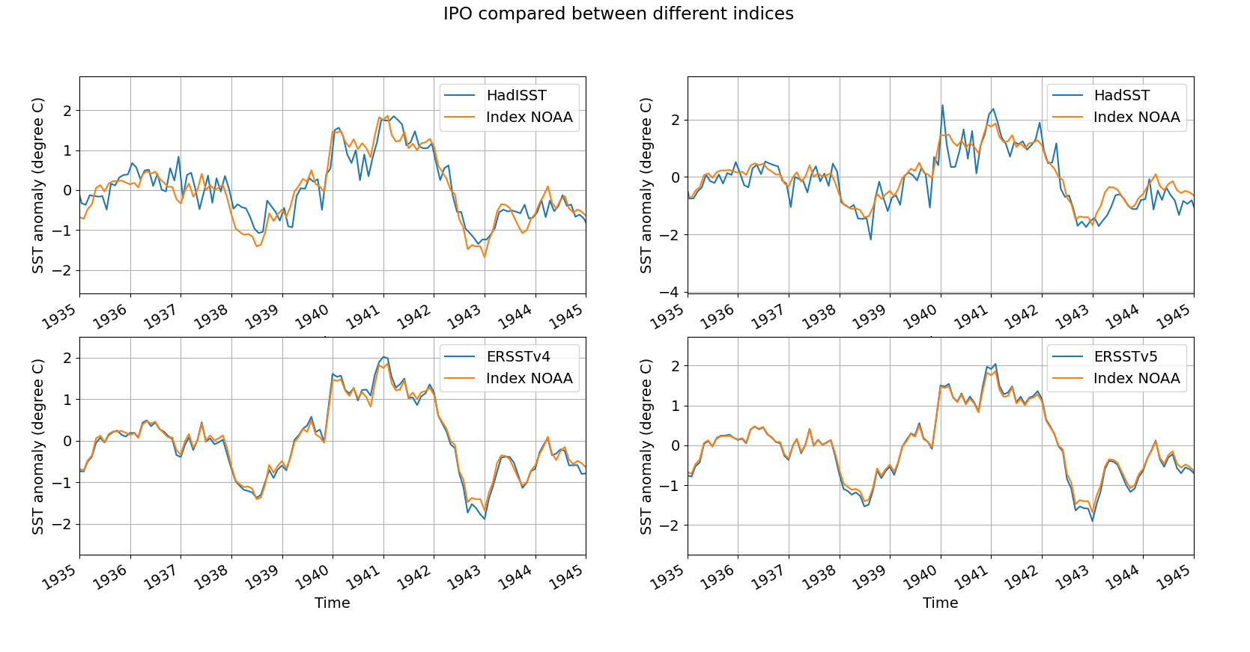
Henley, B. J., Gergis, J., Karoly, D. J., Power, S., Kennedy, J., & Folland, C. K. (2015). A tripole index for the interdecadal Pacific oscillation. Climate Dynamics, 45(11-12), 3077-3090.
IPO: index should be based on ERSSTv5

Slide 33
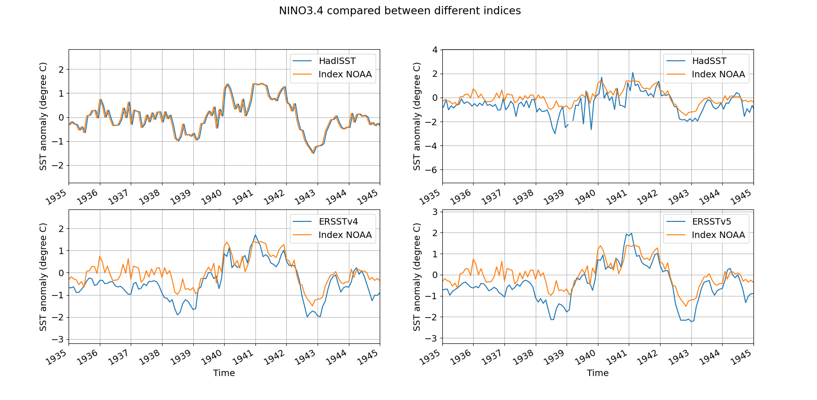

Slide 34
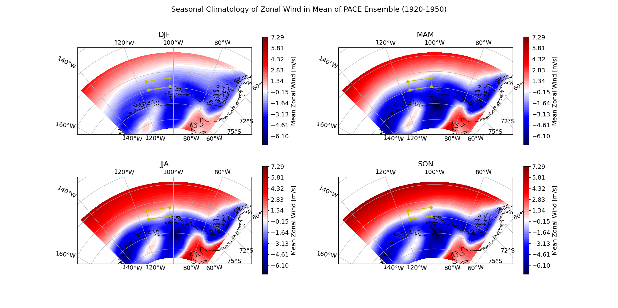

Slide 35
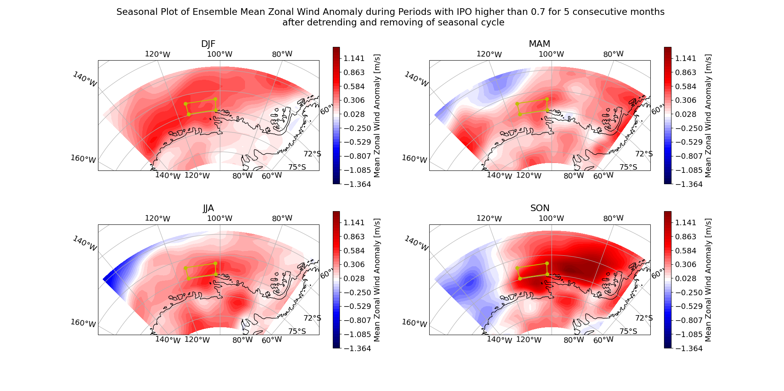

Slide 36
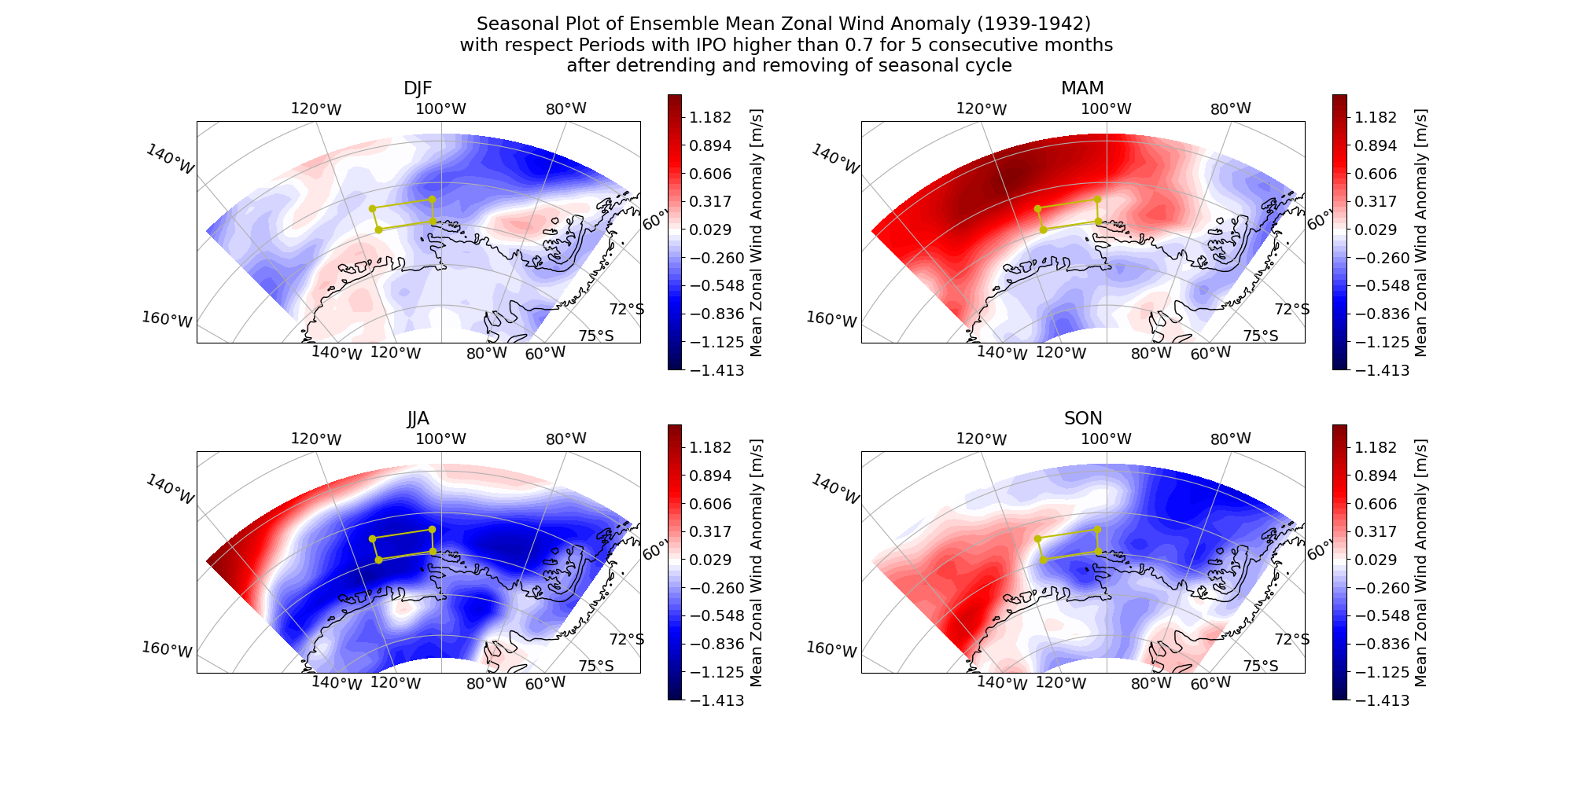

Slide 37
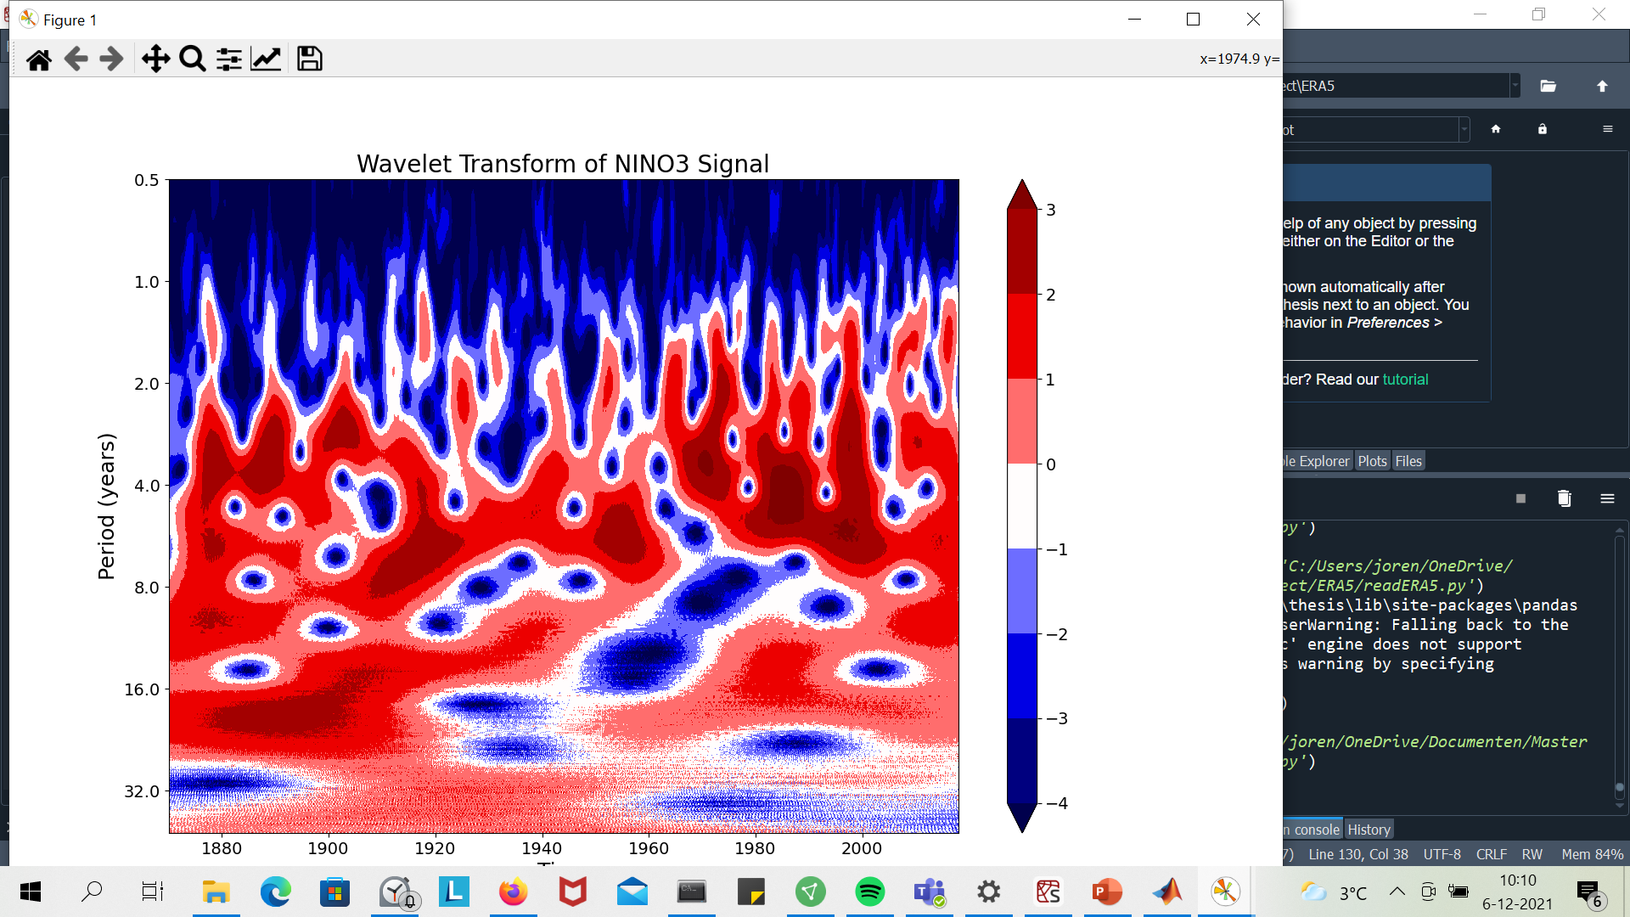
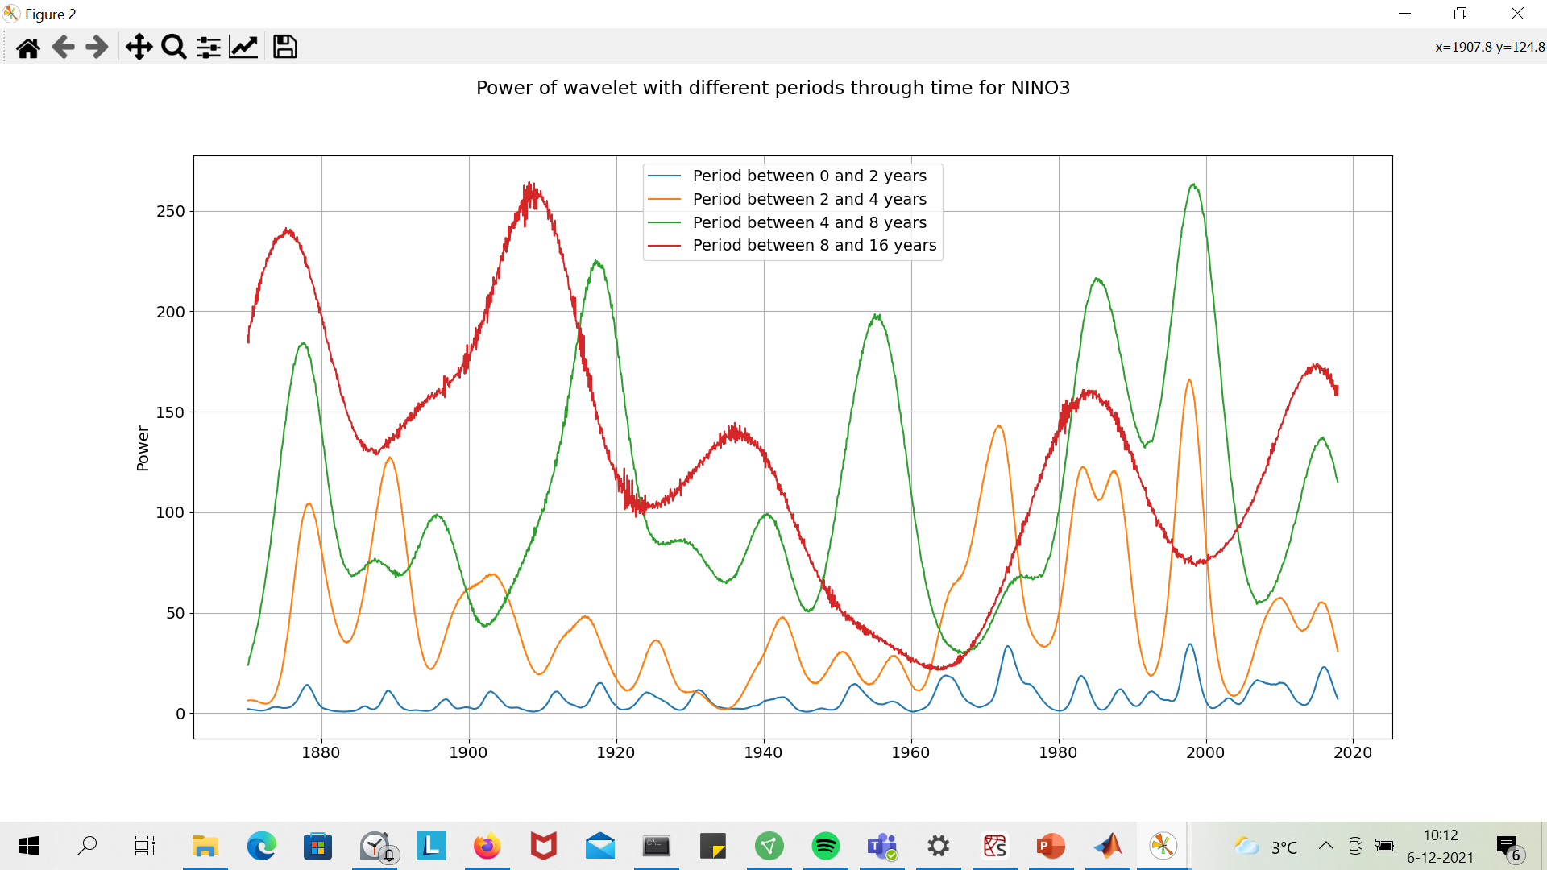
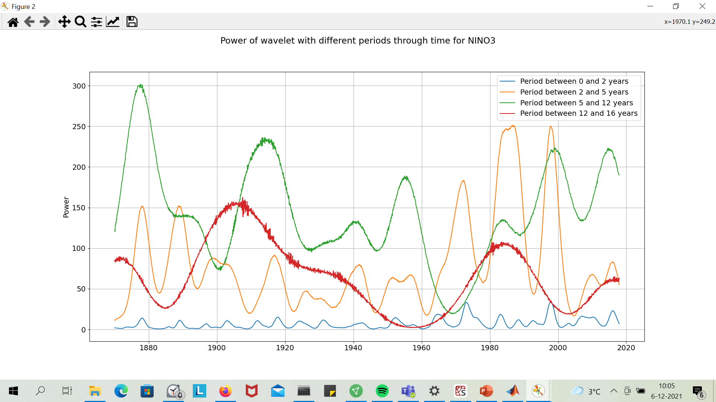
How to normalize?

Slide 38
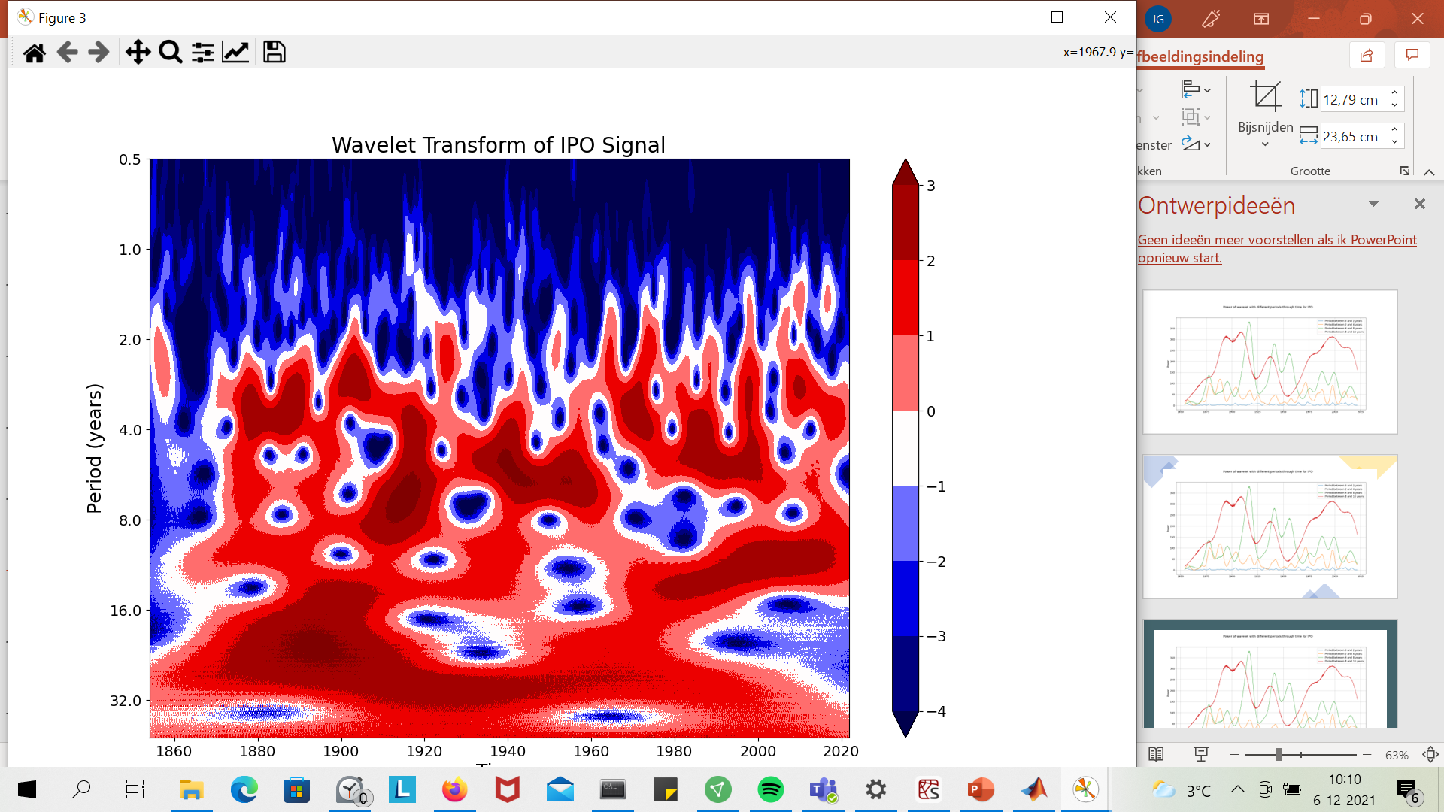
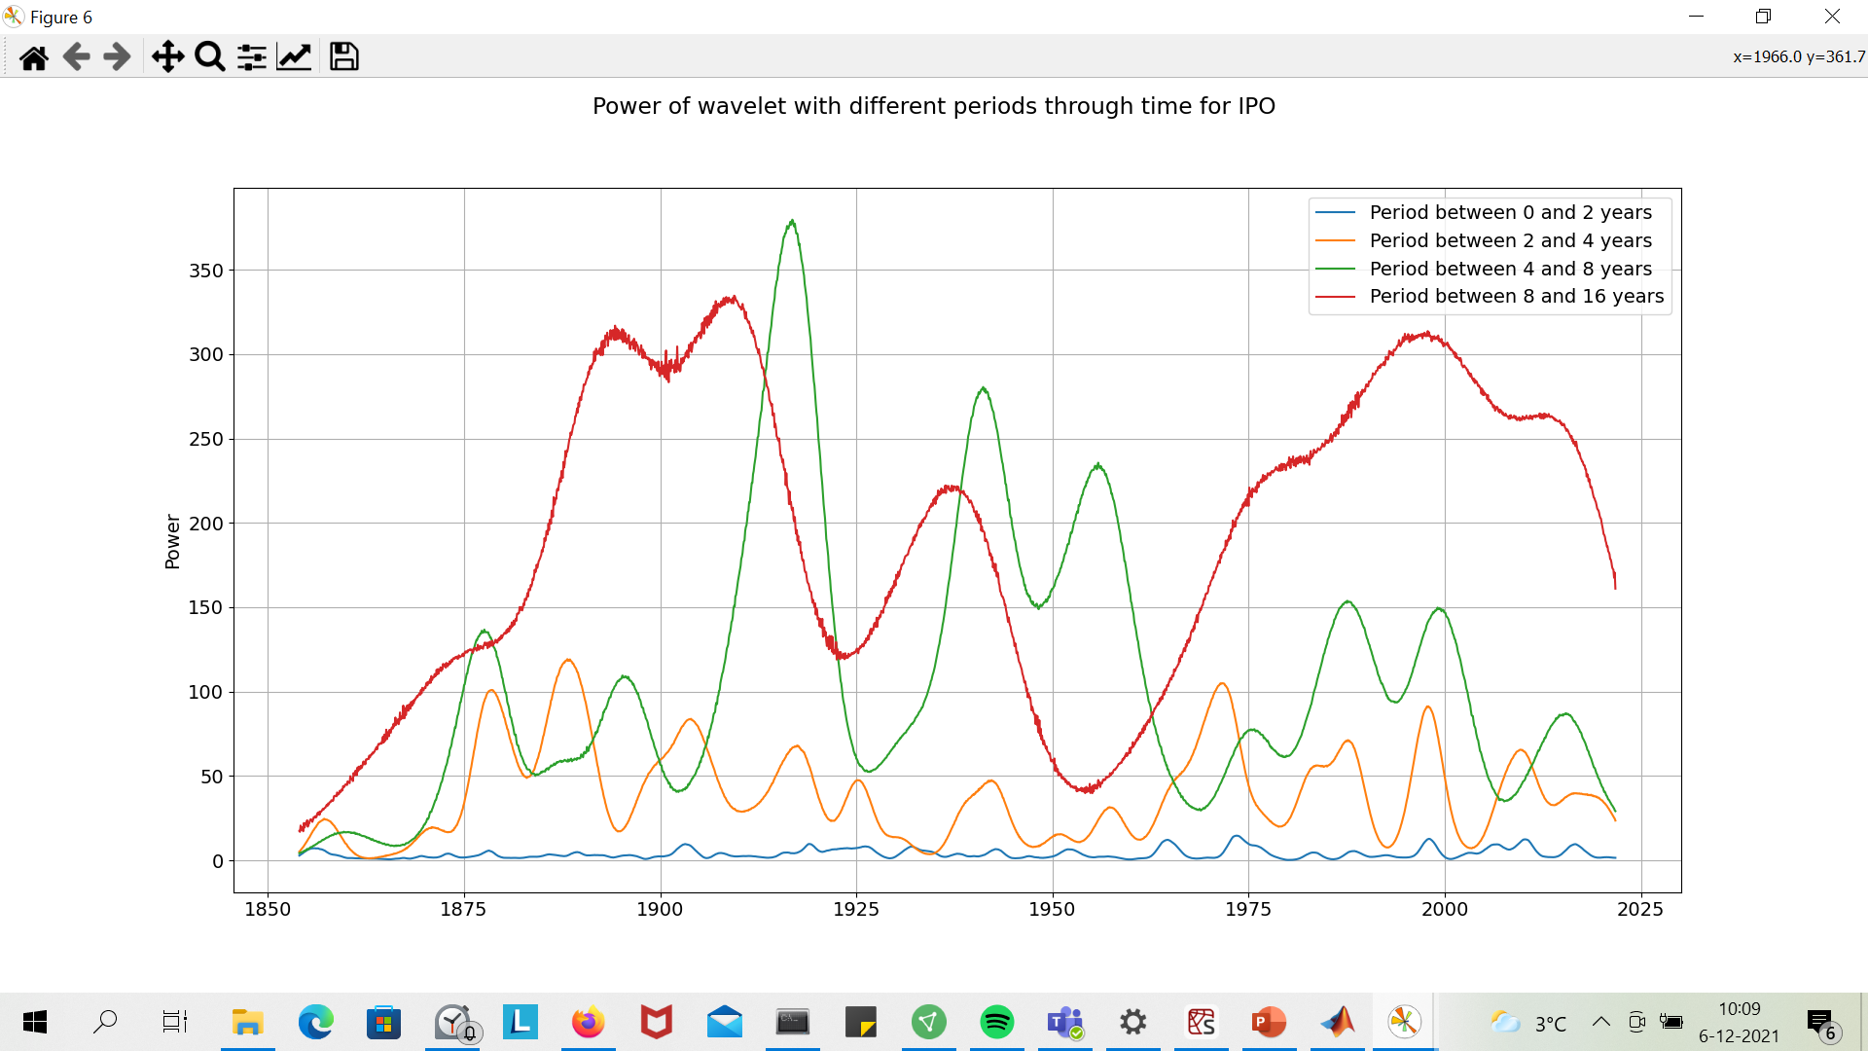

Slide 39
Fig 1A Naughten (concept)
Fig 3A Holland et al., 2019

Slide 40
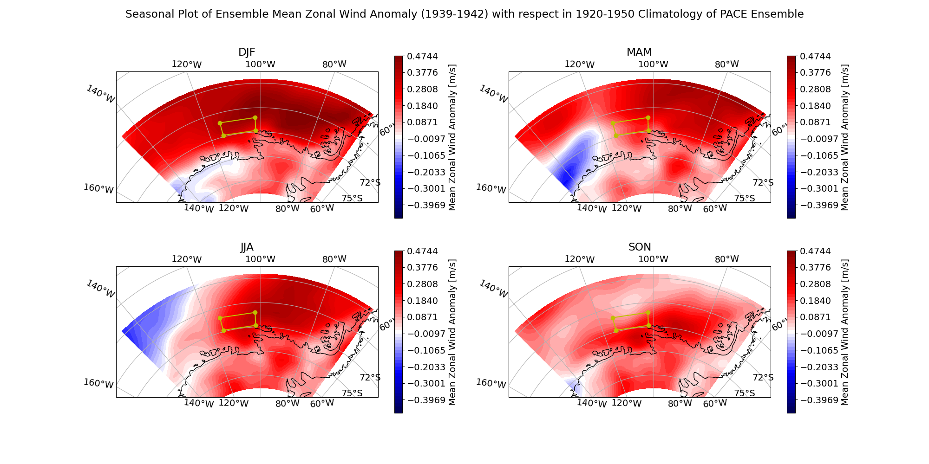

Slide 41
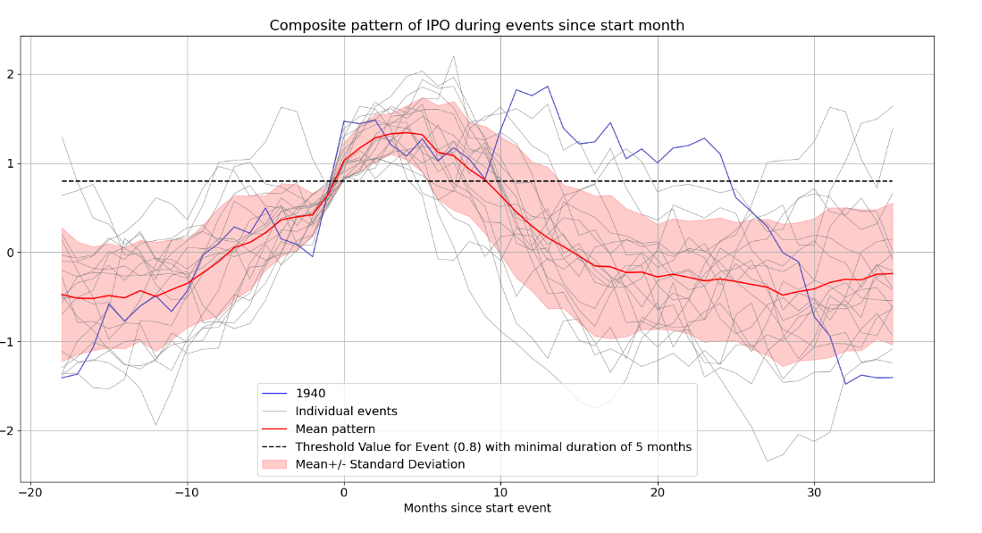
One or two seperate events? Depends on index

Slide 42
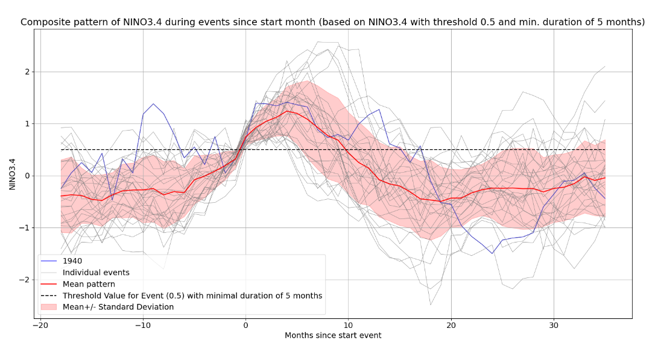
One or two seperate events? Depends on index

Slide 43
